Slide 1
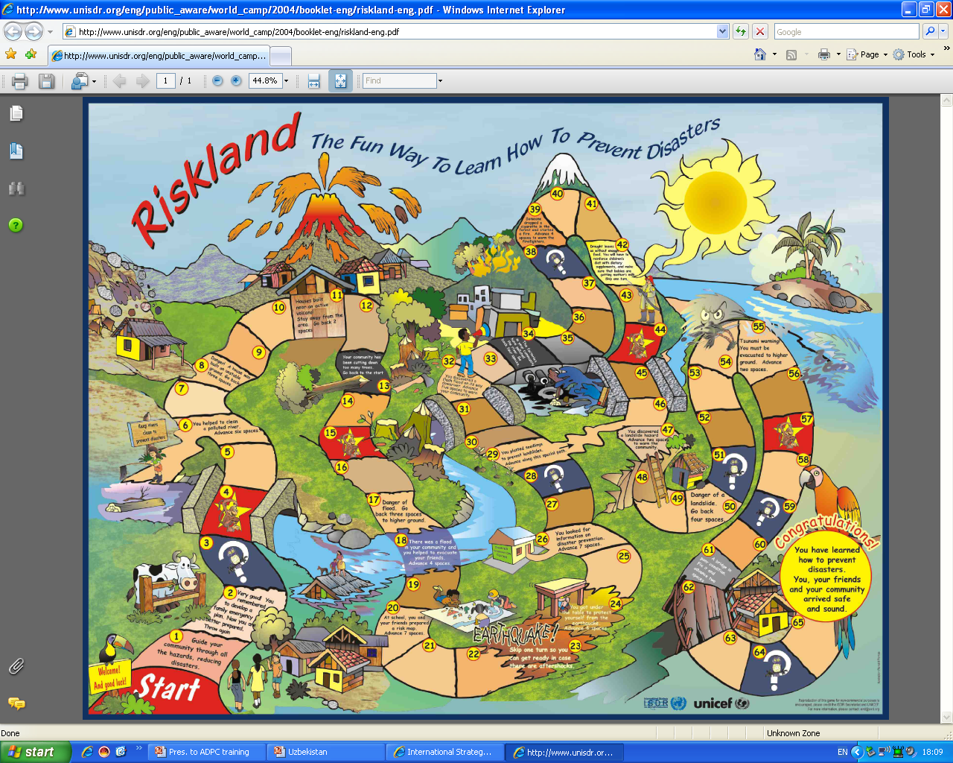
UNICEF ICO DRR programme overview
the DRR mainstreaming initiatives of UNICEF in country programmes across five thematic areas – Education, Health, Nutrition, WASH and Child Protection
Notes:
UNICEF and the U N International Strategy for Disaster Reduction and have together produced an educational kit for children called “Let’s learn to prevent disasters!”. It includes the board game 'Riskland' whereby players learn about what they can do to reduce disaster impacts by answering questions and advancing along the board’s winding path.

Slide 2
Indian Scenario
Probabilistic assessment by the Global Assessment Report (UNISDR) estimates expected direct average annual losses for India at $10 billion per year
India along with China is placed as top four countries (others include Japan, USA) as "high risk" in absolute economic exposure due to natural hazards (Natural Hazards Risk Atlas 2014 by British Risk Assessors Maplecroft)
Crop loss in Telangana was estimated to be in 494 hectares during 2016 Sept floods.
The food grain production was 6.5 million tonnes in 2015-16 as against the target of 11.1 million tonnes
Livestock management, especially poultry (57 cr loss between may and june 2015) . Impacts livelihood and income of families

Slide 3
Why DRR is possible in India
A Qualitative Shift in India's Strategy: The Government recognised the need for a shift from a post disaster reactive approach to a pre-disaster pro-active approach: Preparedness Mitigation Prevention This will minimise the damage, losses and trauma to the people on one hand and reduce the costs of relief, rehabilitation and reconstruction.
The Disaster Management Act 2005 - enacted on 23rd December,2005 lays down institutional and coordination mechanism at all level and provides for establishment of Disaster Mitigation Fund and Disaster Response Fund at national, state and district level.
This shift in strategy is feasible because of: Advancements in Science and Technology · Effective implementation has shown decline in casualties. · Advancements in forecasting technologies and warning systems Government policy to strengthen Hazard Mapping, R&D and Standardisation, Enlargement and reinforcement of disaster prevention systems, equipment and facilities.

Slide 4
Why DRR should be a priority
The objectives of India's National Policy for natural disaster reduction is to reduce: loss of lives property damage and economic disruption (SFDRR) hence it is vital to:
Creating Public Awareness about Safety from Disasters
Amending/Enacting legislation for safety from Hazards.
Constructing new buildings that are safe from Hazards.
Retrofitting existing buildings for improving hazard resistance (Building Codes)
Legislation Needed Amendments to town/country planning acts and Master plan area development rules. Land use zoning in hazard prone areas and establishing techno-legal regimes
Promotion of Early Warning Systems and Upgrading of EOC
Empowering local bodies to exercise control Legislation to upgrade hazard resistance of critical buildings for use and safety of large number of people - schools, hospitals, cinemas, congregation halls, water tanks, towers, telephone exchanges, fire stations, headquarters of police and administration
Programs to rejuvenate irrigation tanks and afforestation
Notes:
Building code (also building control or building regulations) is a set of rules that specify the standards for constructed objects such as buildings and non- building structures. Buildings must conform to the code to obtain planning permission, usually from a local council. The main purpose of building codes is to protect public health, safety and general welfare as they relate to the construction and occupancy of buildings and structures. The building code becomes law of a particular jurisdiction when formally enacted by the appropriate governmental or private authority

Slide 5
Disaster impact on children in India?
Children and women among most vulnerable, 70% of disaster victims, disproportionally affected
Gender inequalities increase vulnerability of women and girls.
2000-2016: In five major natural disasters 17,671 children lost their lives, an equal number of children was injured -19,466 schools were destroyed
2015-16 drought in ten States affected 330 million people, including 37 mn children under five. It affected UNICEF programme results in WASH, education, nutrition, health and child protection
One third of India’s territory also affected by civil strife.
2015-16 floods 5 mn children affected/ displaced, social service delivery disrupted
No disaggregated data available on children deaths/ health related problems either in Telangana or any other states.

Slide 6
The Children’s view
Schools must be safe - education must be uninterrupted.
Child protection must be a priority, before, during and after a disaster.
Children and young people have the right to participate and to access the information they need.
Community infrastructure must be safe, and relief and reconstruction must help reduce future disaster risk.
Disaster risk reduction must reach the most vulnerable.

Slide 7
Why involve children and youth
Change in the whole thinking process and attitude (children can contribute to DRR at community and family level)
Invisible ---------→ Visible
Children and youth should not be considered homogenous sets (diversity within these groups)
Recognize and promote children and youth’s contribution
Child friendly environment, tools and techniques
Forming/recognizing children and young people organization (working with them)
Groom children and youth as future leaders

Slide 8
Bottlenecks
Despite evidence, understanding of the extent of disaster risks and impact on children in India remains limited
No comprehensive information management system to assess child’s vulnerability, capacities and multi-dimensional impact of acute, chronic and recurrent incidents of disasters – impact on malnutrition, service delivery, discontinuation of education etc.
Consequently, duty-bearers do not sufficiently anticipate the risk and failed to provide adequate response to reduce risks and mitigate the impact of disasters on children
GoI disaster management institutions, sectoral policies and UNICEF support to related programmes are so far only partially informed by disaster risk reduction approaches. They do not (yet) follow a systems approach to build resilience

Slide 9
Our proposed strategic approach
The output seeks to overcome these bottlenecks through key strategies including:
Advocating for scaling-up risk informed programmes
Applying a systems approach to risk governance,
Integrating risk considerations into departments and district administrations

Slide 10
Our advocacy
Shift from disaster management (response and relief) to disaster risk management (preparedness and mitigation)
Articulation of a governance approach to manage disaster risk(mainstream into development planning)
Increased engagement of Local Governments
Resilience of health infrastructures and work places
Strengthened accountability for disaster risk management;
Mobilization of risk-sensitive investment and risk transfer mechanisms

Slide 11
Priorities of SFDRR
SFDRR has 4 Priorities:
Understanding Disaster Risk
Strengthening Disaster risk Governance to Manage Disaster Risk
Investing in Disaster Risk Reduction for Resilience
Enhancing Disaster Preparedness for effective Response, and to “Build Back Better” in recovery, rehabilitation and reconstruction

Slide 12
Targets of SFDRR 2015-30
Target 1. Substantially Reduce Disaster Mortality by 2030
Target 2. Substantially reduce the number of affected people globally by 2030
Target 3. Reduce direct disaster economic loss in relation to gross domestic product by 2030.
Target 4. Substantially reduce disaster damage to critical infrastructure and disruption of basic services, including through developing their resilience by 2030.
Target 5. Substantially increase the number of countries with national and local disaster risk reduction strategies by 2020
Target 6. Substantially enhance international cooperation to developing countries through adequate and sustainable support to complement their national actions for implementation of present framework by 2030
Target 7. Substantially increase the availability of and access to multi-hazard early warning systems and disaster risk information and assessments to the people by 2030.

Slide 13
Implementing the Sendai Framework and Action to be taken at local level
Priority 1: Understanding Disaster Risk
Organize sensitization meetings on Disaster Risk
Create Disaster Damage Data base for the district
Priority 2: Strengthening Disaster Risk Governance to Manage Disaster Risk
Urban local bodies and the Panchayats to follow building bye-laws.
Identify flood prone/earthquake prone areas - future construction of buildings to be earthquake proof and flood resilient

Slide 14
SFDRR continued
Priority 3: Investing in Disaster Risk Reduction for Resilience
10% of all funds at the District level must be devoted to schemes which will help in DRR
Sensitize Private builders about the need for disaster resilient building construction
Train masons/contractors on disaster resilient building construction
Priority 4: Enhancing Disaster Preparedness for effective Response
Regular meetings of DDMAs (once in 3 months) even if there is no calamity and discuss preparedness
Meetings with the Forecasting Agencies during the sesaons (Summer, Monsoon and Winter)
Prepare Standard Drill for responding to Disasters (Heatwave, Drought, Cyclone/Flood/Tsunami etc. with stakeholders. Review your SOPs
Prepare for heatwave in summers and cold wave in winters as applicable
Conduct regular drills involving the Police, Civil Defence and Fire Services
Impart training to village level workers to promote disaster sensitivity

Slide 15
Challenges
Out of school children
Some of the most vulnerable areas are very remote
Access to rights and entitlements (education and health services)
Demystify the concept –
DRR: It is a priority for the community?
Is DRR a priority for the government? (category)
New concept and evolving
“Natural Hazards and human induced Disasters”

Slide 16
What we all could do- Science and technology
Enlightened souls and ignited minds (torch bearers/ Champions)
First self-> Family -> Community -> larger goals
Understanding of the issue from a practical perspective (lab to land)- Science ; Techno-social solution
From groups, clubs; involve with scouts, guides, NCC/NYK
Promote a culture of preparedness
Mainstream mitigation measures in development planning
Extensive use of communication modes

Slide 17
Suggested possible actions for heatwave management
Terminologies to be decoded for laypersons understanding and communicated widely
Administration functioning time could change, as in the case of Gulbarga division of Karnataka
Directions to MGNREGA to ensure works are conducted during peak hours
Administration to highlight traditional methods in managing heatwave (cost effective).wet cloth on the floor or bucket of water under the ceiling fan, reduces heat in the houses.
Availability of ORS/ Electrolytes and sufficient water at AWC, Schools and Health Service (PHC and Hospitals)

Slide 18
Suggested … for long term strategies
Trees and Vegetation - Increasing tree and vegetation cover in schools and AWCs that UNCIEF is facilitating with (500 schools)
Green Roofs for schools and AWCs- Growing a vegetative layer (plants, shrubs, grasses, and/or trees) on a rooftop reduces temperatures.
School level awareness on management of heatwave – under the school safety program (CSS)
Replicate good practices – road side cold water available in Delhi (sold for rs. 2 per glass – all bus stops, street corners etc.)
Notes:
Also called “rooftop gardens” or “eco-roofs,” green roofs achieve these benefits by providing shade and removing heat from the air through evapotranspiration.
Cool Roofs - Installing a cool roof – one made of materials or coatings that significantly reflect sunlight and heat away from a building – reduces roof temperatures, increases the comfort of occupants, and lowers energy demand.
Cool Pavements - Using paving materials on sidewalks, parking lots, and streets that remain cooler than conventional pavements (by reflecting more solar energy and enhancing water evaporation) not only cools the pavement surface and surrounding air, but can also reduce stormwater runoff and improve nighttime visibility.
Smart Growth - These practices cover a range of development and conservation strategies that help protect the natural environment and at the same time make our communities more attractive, economically stronger, and more livable.

Slide 19
Revival of traditional beverages in rural and urban households
Onion Juice Tamarind Drink
Aam Panna Buttermilk and Coconut Water
Juice of Coriander and Mint Leaves (road side)

Slide 20
UNICEF- Hyderabad Field Office
Telangana :
Working closely with DM Department and MCR-HRDI to strengthen the capacity of key stakeholders in the development disaster management plans, workshops and seminars related to DRR.
Rapid assessment of drought conducted in 2016 and planning to undertake implementation of drought mitigation measures in 2017 with the support of DM Department and District Administration in 2 districts.
Proposal in pipeline to build capacities of youth in Khamman district to DRR and school safety program in 2 districts
Developing of ICT materials for mass awareness

Slide 21
Conti…
Andhra Pradesh:
School safety program in 4 districts.
Capacity building program on DRR to officials through AP-HRDI
Urban Climate Change Resilience pilot project in Vizag
Karnataka: Drought study in 2 districts; preparation of HRV Atlas of 4 districts.
Drought Mitigation project in 1 block on pilot basis

